Slide 1
LECTURE # 04 SAMPLING AND ITS METHODS

Slide 2
SAMPLING
A method or process of selecting some part of a group to represent the total.
Total group is called as population
Part of the total group that is selected is called as sample.
The process which involves taking a sub-group of the population, making observation on this representative group and then generalizing the findings to the bigger population is termed as sampling.

Slide 3
POPULATION
Defined aggregate of persons, objects or events that meet a specified set of criteria .
Larger group to which research results are generalized
Populations are not necessarily restricted human subjects, May include people, places, organizations, objects, animals, days or any unit of interest.
For Example
Housing units in a household survey
Blood samples in an medical study
Inventory of manufactured products in industry

Slide 4
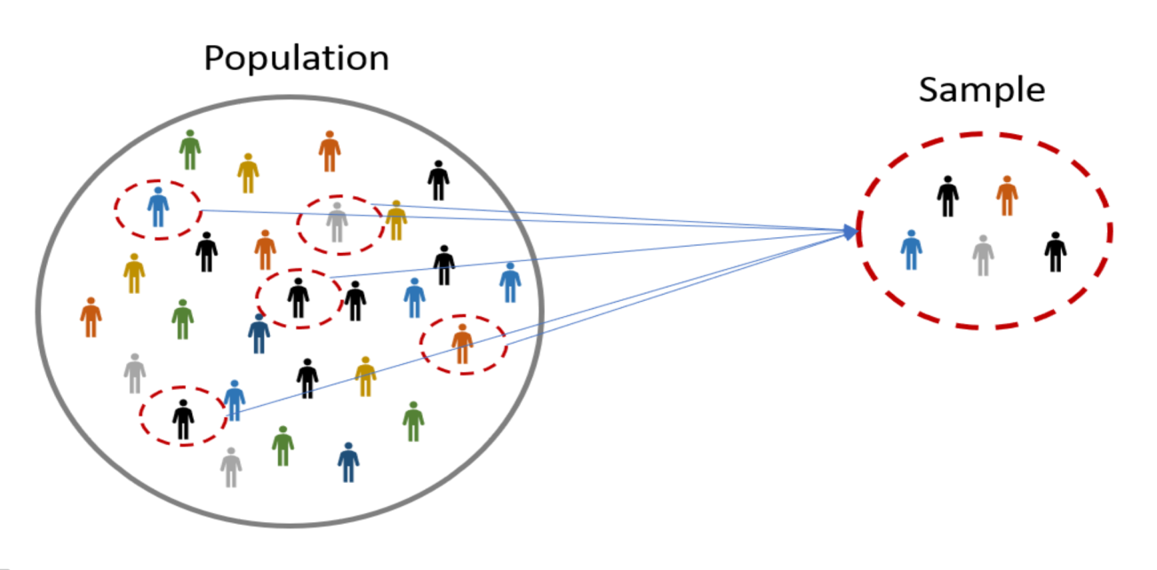
SAMPLE
Sub-group of the population .
Serves as reference group for estimating characteristics or drawing conclusions about the population.

Slide 5
PARAMETER AND STATISTIC
A PARAMETER is a characteristic or measure obtained by using the data values from a specific population.
Greek letter is used to symbolize the parameter.
E.g. the "average" age at time of admission for all students.
A STATISTIC is a characteristic or measure obtained by using the data values from a sample.
English alphabet is used to symbolize the statistic.
E.g. the "average" height, found by using the set of 25 heights.

Slide 6
ADVANTAGES OF SAMPLING
No need to get information about everyone
Save time. Reduces the length of time needed to finish study
Save money
Save energy
Less data so limited error (fewer opportunities to make mistake) — Improved quality
Better supervision and record keeping

Slide 7
METHODS OF SAMPLING
Probability sampling
Every element in the population has equal probability of selection in the sample.
Involves random selection at some point.
Non-Probability sampling
Every item in a population does not have an equal chance of being selected.
Selection of samples is based on personal judgment.
Convenient and economical
Quality depends on knowledge, judgment and expertise of researcher

Slide 8
METHODS OF SAMPLING
SAMPLING METHODS
PROBABILITY SAMPLING
1. Simple Random Sample
2. Systematic Sample
3. Stratified Sample
4. Cluster Sample
5.Multi Stage Sample
NON-PROBABILITY SAMPLING
1. Convenience Sample
2. Quota Sample
3. Snowball Sample
4. Judgement Sample

Slide 9
SIMPLE RANDOM SAMPLING
Randomly selecting a sample in such a way that every item in a population has an equal chance of being included in the sample.
Easiest and least complex
Suitable for homogeneous population
The personal bias of the researcher is not involved.

Slide 10
Cont..

Slide 11
SYSTEMATIC RANDOM SAMPLING
Selecting the k^{th} item from a population with a random start
k is the sampling ratio that may be computed from the following formula.
k = N/n
Where
N = Population Size
n = Sample Size

Slide 12
Cont..

Slide 13
STRATIFIED RANDOM SAMPLING
The population is divided into homogeneous groups and these groups are named strata.
Then, a sample of specified size is selected from each strata by random sampling method.
The total of sub-samples will constitute the full sample.
It increases the efficiency of sampling by dividing heterogeneous population into sub-groups in such a way that there is homogeneity within groups and heterogeneity between groups.
It reduces the sampling errors.
Greater precision than simple random sampling.

Slide 14
Cont..

Slide 15
CLUSTER OR AREA SAMPLING
Subdivide the population into smaller clusters.
Select the clusters by simple or systematic random method to makeup the overall sample.
The probability of selecting an element is the probability of selecting its cluster .
Different from stratified as element may be heterogeneous. (In stratified they are homogenous) .
Used when population is scatted over a wide area.
Also known as area sampling as it is frequently applied on a geographical basis.

Slide 16
Cont..

Slide 17
MULTI-STAGE SAMPLING
If more than two stages are involved in obtaining the overall sample, it is known as multi-stage sampling.
Cluster sampling and stratified sampling are the examples as two stages of sampling are involved.

Slide 18
CONVENIENCE OR ACCIDENTAL SAMPLING
A unit is self-selected (e.g. volunteers) or easily accessible/available.
It is not normally representative of the target population because sample units are only selected if they can be assessed easily and conveniently
Although may yield useful information, caution with making inferences.

Slide 19
JUDGEMENT OR PURPOSIVE SAMPLING
Researcher selects the subjects on basis of specific characteristics or attributes that are important to the research study.
It is ensured that subjects have appropriate knowledge and will be good informants for the study.

Slide 20
SNOWBALL SAMPLING
Select a few subjects who meet selection criteria
Ask selected subjects to identify others who have requisite characteristics
Repeat process of "chain referral" or "snowballing" till adequate sample size obtained
Useful if hard to locate subjects with specific characteristics

Slide 21
QUOTA SAMPLING
In quota sampling, the population is first segmented into mutually exclusive sub-groups, just as in stratified sampling.
Then judgment is used to select the subjects or units from each group based on a specified proportion.
Preferable to other forms of non-probability sampling (e.g., convenience & judgment sampling) because it forces the inclusion of members of different sub-populations.

Slide 22
STRATEGIES FOR DETERMINING SAMPLE SIZE
Using a Census for small populations
Using a Sample Size of a Similar Study
Using Formula to Calculate a Sample Size

Slide 23
USING A CENSUS FQR SMALL POPULATION
Use entire population as sample
Useful for small population
Eliminates sampling error
Provides individual level data

Slide 24
USING A SAMPLE SIZE OF A SIMILAR STUDY
Could be a valuable approach but without reviewing the procedures employed, may include risk of repeating errors made previously.
Review literature to get guidance on "typical" sample size

Slide 25
USING FORMULA TO CALCULATE THE SAMPLE SIZE
Yamane’s Formula
Where
n =Sample Size
N = Population Size
e = Level of precision or Sampling error
(Percentage allowance for the non- precision because of the use of sample instead of the population)
n =
Reference: Yamane , Taro. 1967, Statistics, An introductory Analysis , 2nd Ed. New York: Harper and Row

